Slide 1
Oracle Cloud Infrastructure Security
The Practice Workshop
Martin Berger
Stefan Oehrli

Slide 2
OCI Security
1
Introduction
2
Cloud Guard
Hands-On Practice Workshop
3
Data Safe
4
Security Zones
5
Others
6
Summary

Slide 3

Data: The Crown Jewel of Your Organization
Protecting Data to Prevent Liability
Data is a Key Asset: While data holds immense value, it can quickly turn into a major liability if not adequately protected.
Rising Cybercrime: Cybercrime is expected to cause $8 trillion in global damages in 2023, with databases being prime targets due to their concentration of valuable information.
Increasing Regulations: New and expanding data protection laws demand stricter security and accountability.
Notes:
Data is often described as the new gold, a critical asset that drives decisions and fuels innovation. However, just like any precious asset, it must be safeguarded to retain its value.
With cybercrime predicted to reach $8 trillion in damages this year, databases are high-value targets. Bad actors see them as treasure troves due to the wealth of sensitive information they hold.
In addition to cyber threats, businesses are also facing more regulations around data protection. Laws like GDPR and others worldwide require organizations to prioritize data security or face significant penalties.
This slide sets the foundation for our discussion: protecting data is not just about compliance but preserving the very asset that fuels our organizations.

Slide 4
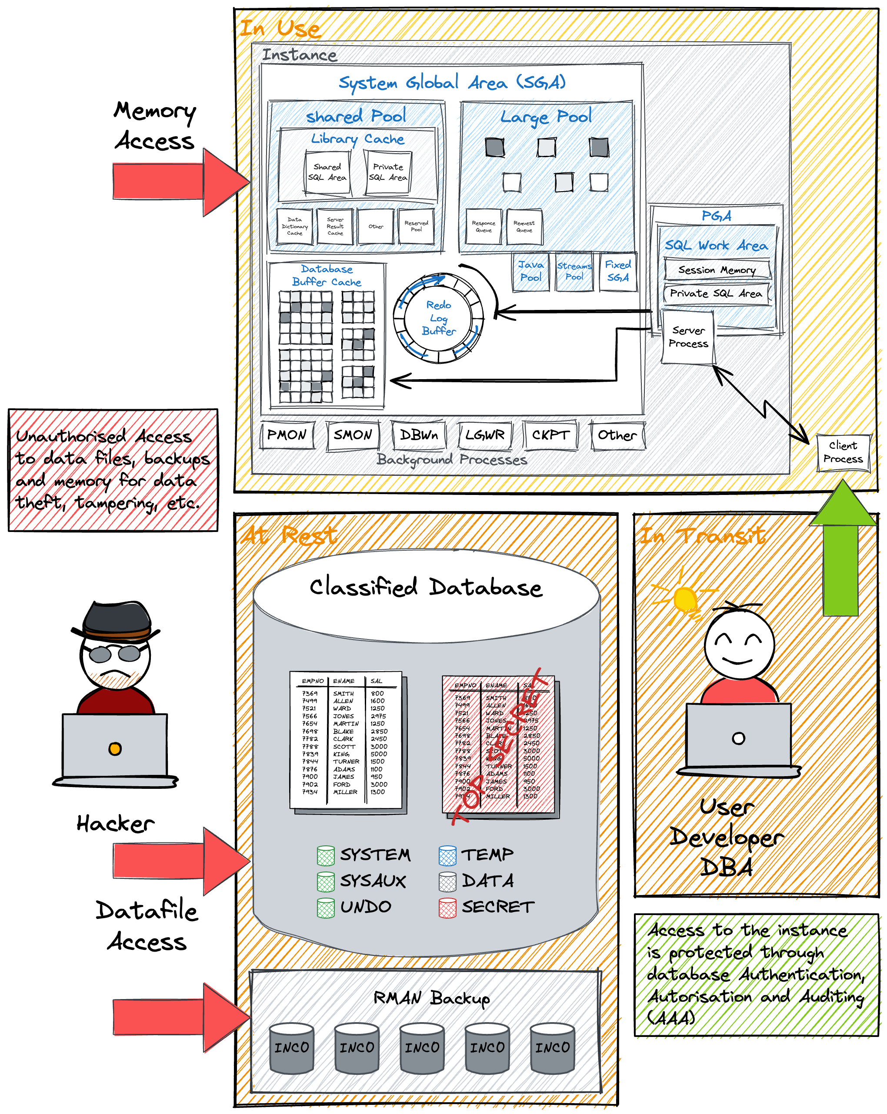
Why Oracle Data Safe?
Beyond Encryption and Patching – Comprehensive Database Security
More Than Basic Security – Encryption and patching are crucial but incomplete.
Key Security Focus Areas:
Configuration Compliance – Is the database securely configured?
User Risk & Monitoring – Who are the highest-risk users, and what actions are they performing?
Audit & Compliance – Which activities should be audited, and how do we manage and protect the audit logs effectively?
Sensitive Data Control – What sensitive data is stored, and can exposure be minimized?
Holistic Security Management – Oracle Data Safe offers centralized tools to address these areas, enhancing control, visibility, and compliance.
Notes:
Introduction:
Oracle Data Safe goes beyond basic encryption and patching. While those are essential practices, they only cover part of what’s needed for comprehensive database security.
Core Security Questions:
Database Configuration: First, Data Safe helps answer critical questions like: ‘Is my database configured securely?’ and ‘Has it drifted from its intended, approved setup?’ Such drift can lead to vulnerabilities, making regular configuration checks crucial.
User Risk and Activity: Second, it’s important to know ‘Who are my highest-risk users?’ and ‘What actions are they performing in the database?’ Data Safe helps identify and monitor these users, ensuring that we stay on top of potential internal threats.
Audit Management: Next, audit logs are critical, especially for compliance. Data Safe helps us decide ‘What should be audited?’ and ‘How do we securely manage the audit trail?’ This way, we can ensure we have a reliable record of database activity.
Sensitive Data Handling: Lastly, it’s essential to understand and control the sensitive data in our databases. Data Safe helps answer, ‘What sensitive data do I hold? How much is there, and can I reduce it?’ This enables us to manage and potentially minimize our data exposure.
Purpose Summary:
Oracle Data Safe provides a proactive, centralized solution for these challenges, enabling us to monitor, secure, and manage database risk. With Data Safe, we address the questions encryption and patching alone cannot solve.

Slide 5
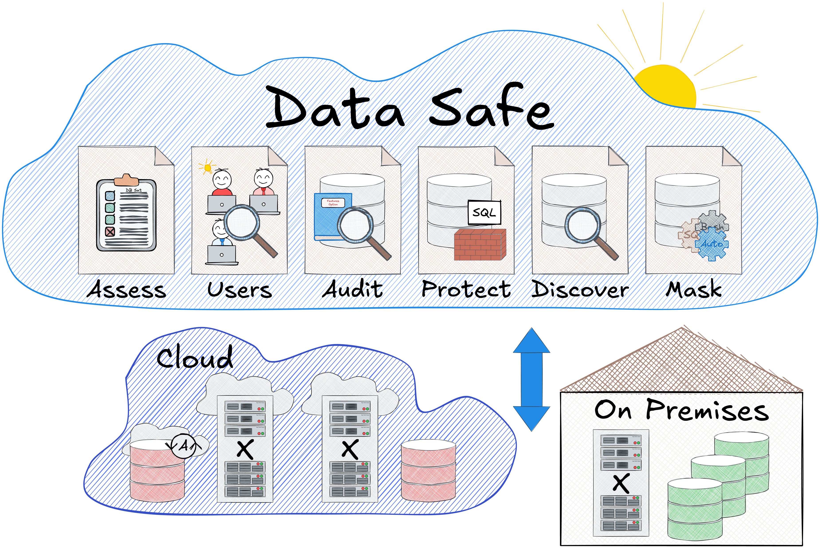
Oracle Data Safe Overview
Centralized Security for Cloud and On-Premises DBs
Unified Security Center – Manage and monitor security for cloud and on-premises databases.
Core Capabilities
Risk Dashboard: Visualizes risk across users, data and configurations.
User Monitoring: Audits user activities to detect potential issues.
Data Masking: Protects sensitive data in test environments.
Future-Ready: Regular updates add new security features.
Key Benefits
Easy & Efficient: No special expertise required—quick setup and automated security.
Risk Mitigation: Saves time and reduces exposure to threats.
Comprehensive Protection: Defense-in-depth security for all Oracle databases.
Notes:
Unified Security Control Center: Oracle Data Safe serves as a single control center for managing database security across cloud and on-premises environments, making it easier to monitor and respond to security needs without juggling multiple tools.
Core Capabilities:
Risk Dashboard: The dashboard gives a clear, visual summary of risks across configurations, sensitive data, and user activity, helping us prioritize and act on security gaps.
User Monitoring: Data Safe’s monitoring capabilities track user activities, helping us detect and respond to potential insider threats.
Data Masking: With masking, we can secure sensitive data in test and development environments, safeguarding it from unauthorized access.
Future-Ready: As a continually evolving platform, Data Safe regularly introduces new features to stay ahead of emerging threats.
Key Benefits: Data Safe’s design allows users of all skill levels to secure their databases quickly and effectively, saving time and offering a layered defense strategy to protect Oracle databases from threats.

Slide 6
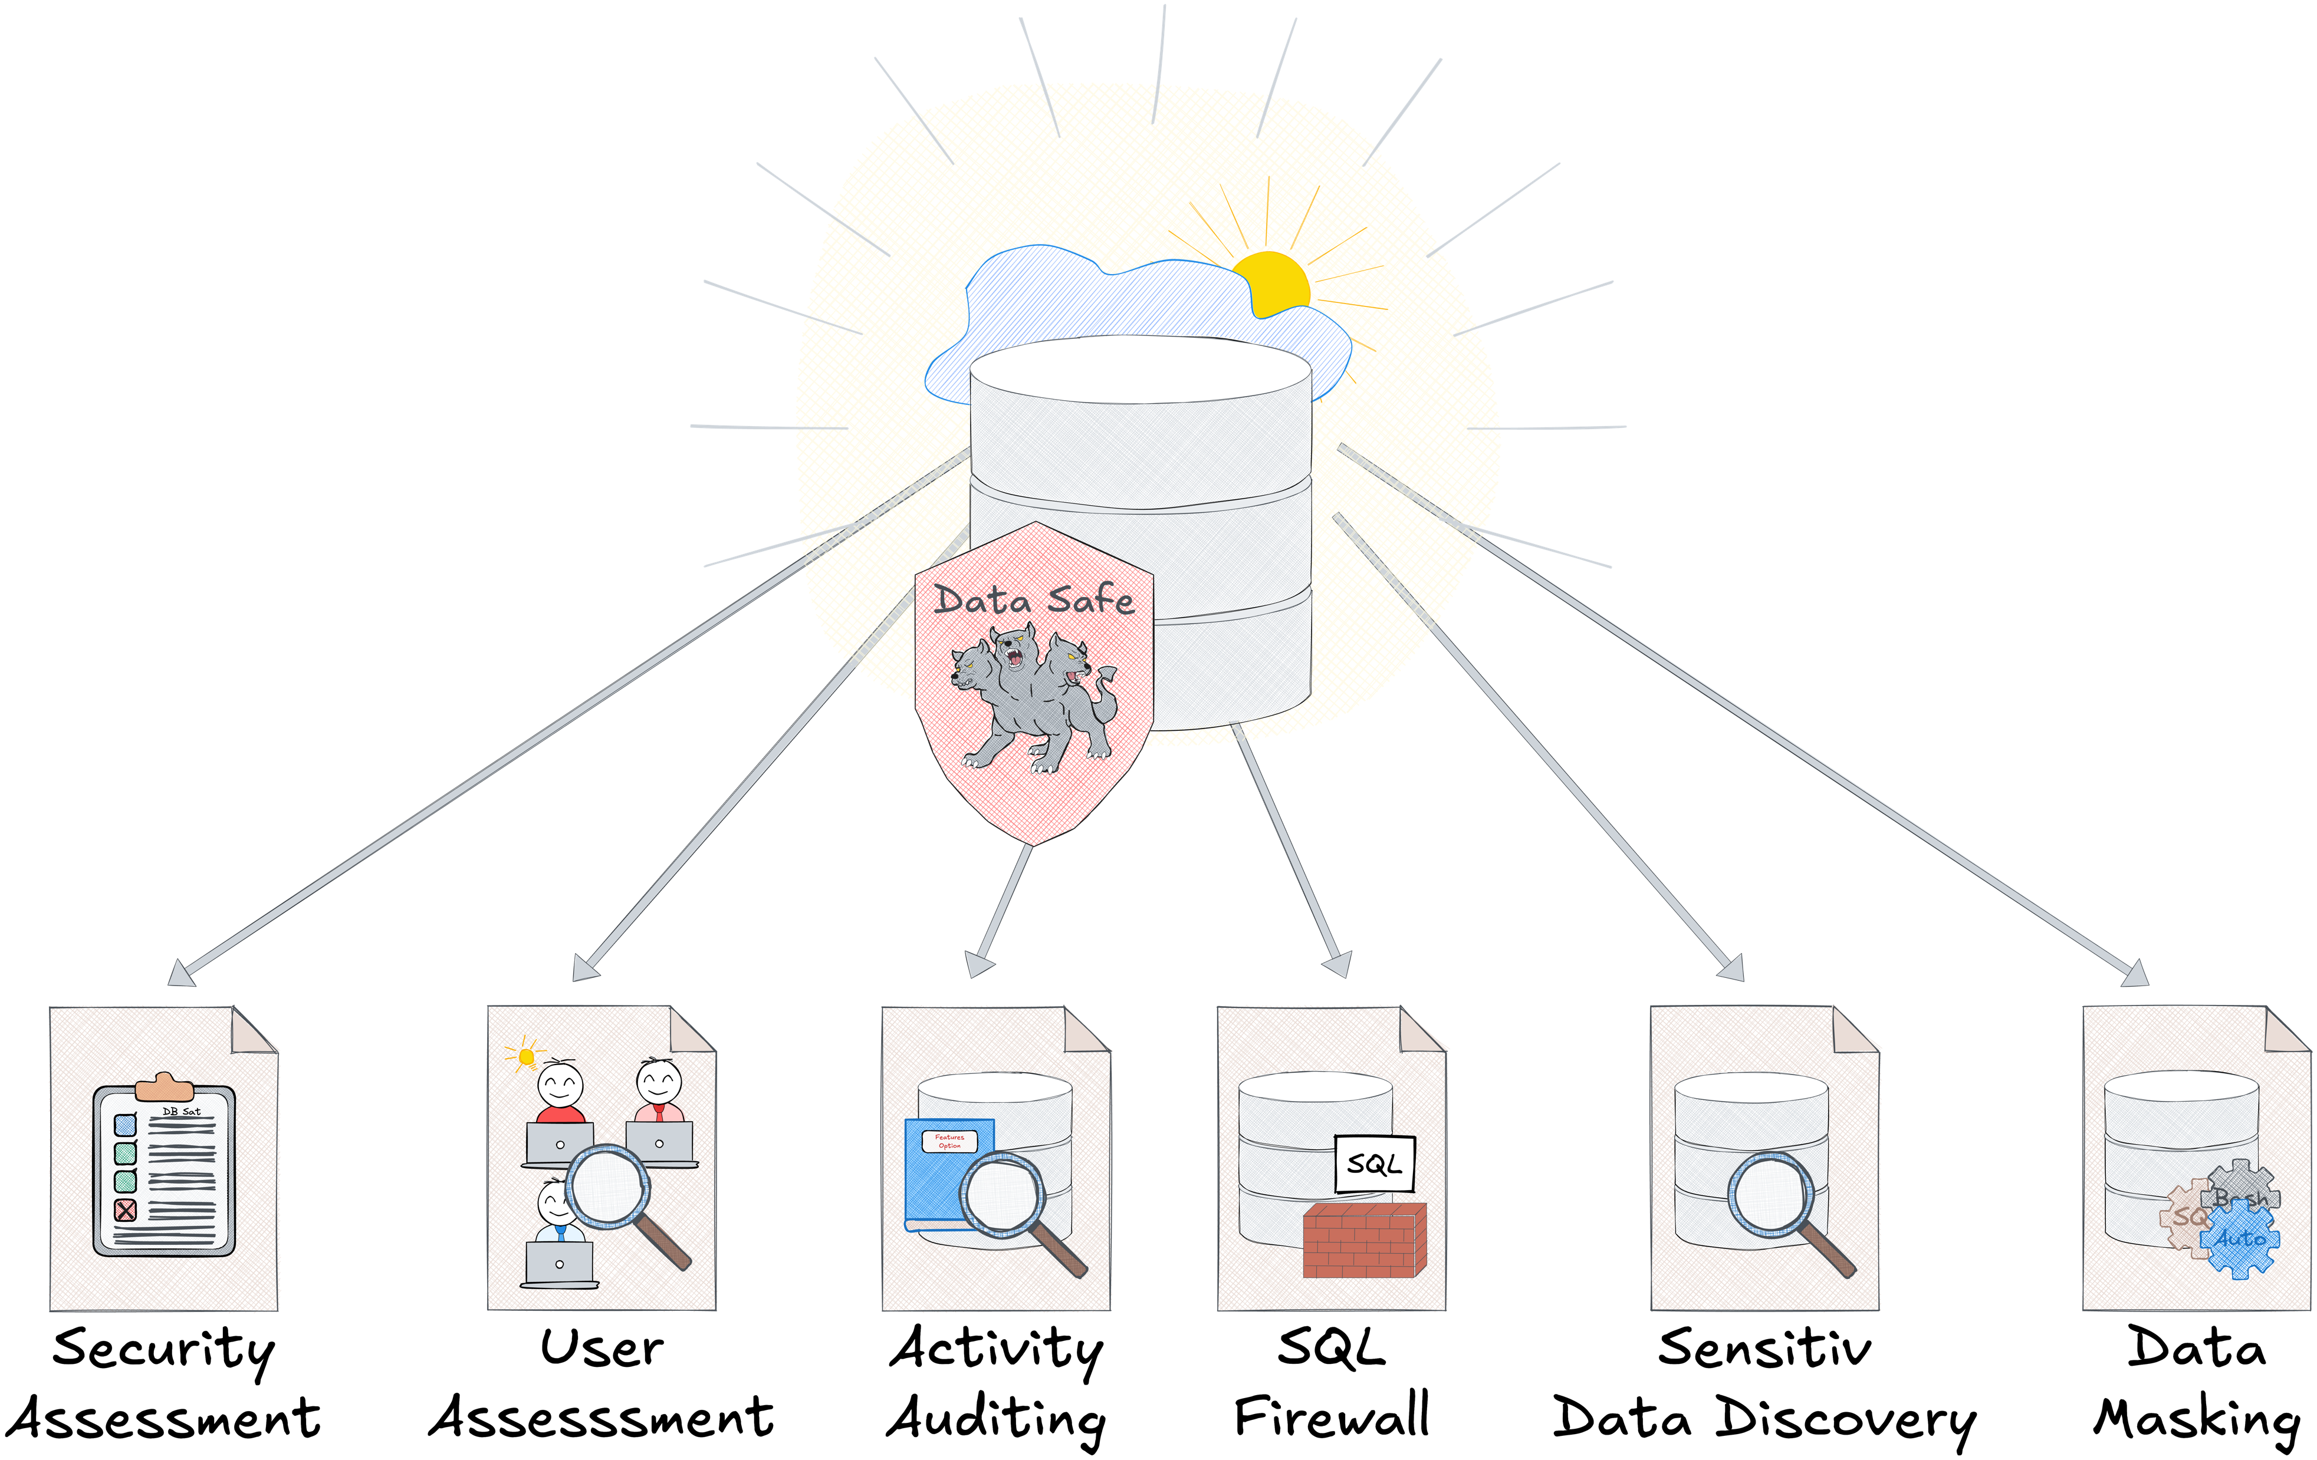
Oracle Data Safe Overview
Key Features for Comprehensive Database Security
Notes:
This illustration shows Oracle Data Safe as a unified security shield for database environments, encompassing multiple key features that enhance security.
Starting from the left, we see Security Assessment, which evaluates configurations for potential vulnerabilities.
User Assessment provides insight into user roles and privileges, identifying high-risk users.
Activity Auditing monitors user actions within the database to ensure compliance and detect suspicious behavior.
SQL Firewall offers a layer of protection, controlling SQL statements to prevent unauthorized data access.
Sensitive Data Discovery helps us locate and catalog sensitive data within the database.
Finally, Data Masking secures sensitive data in non-production environments, such as testing and development.
Together, these features create a defense-in-depth strategy for database security, making it easier to manage and protect both cloud and on-premises databases.

Slide 7
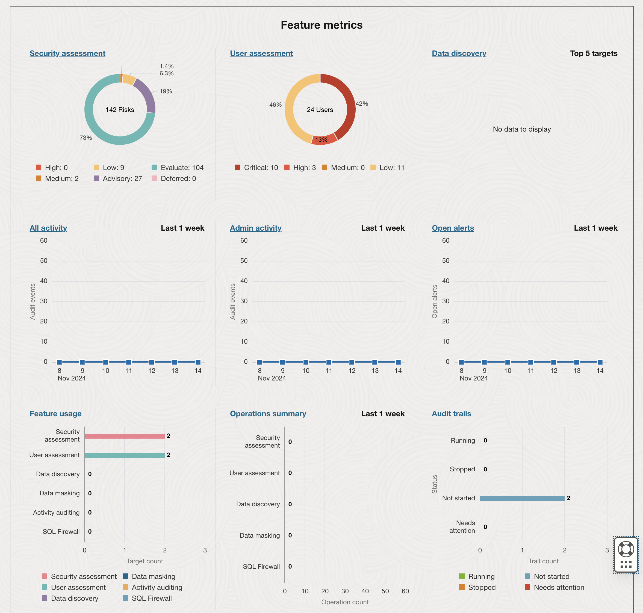
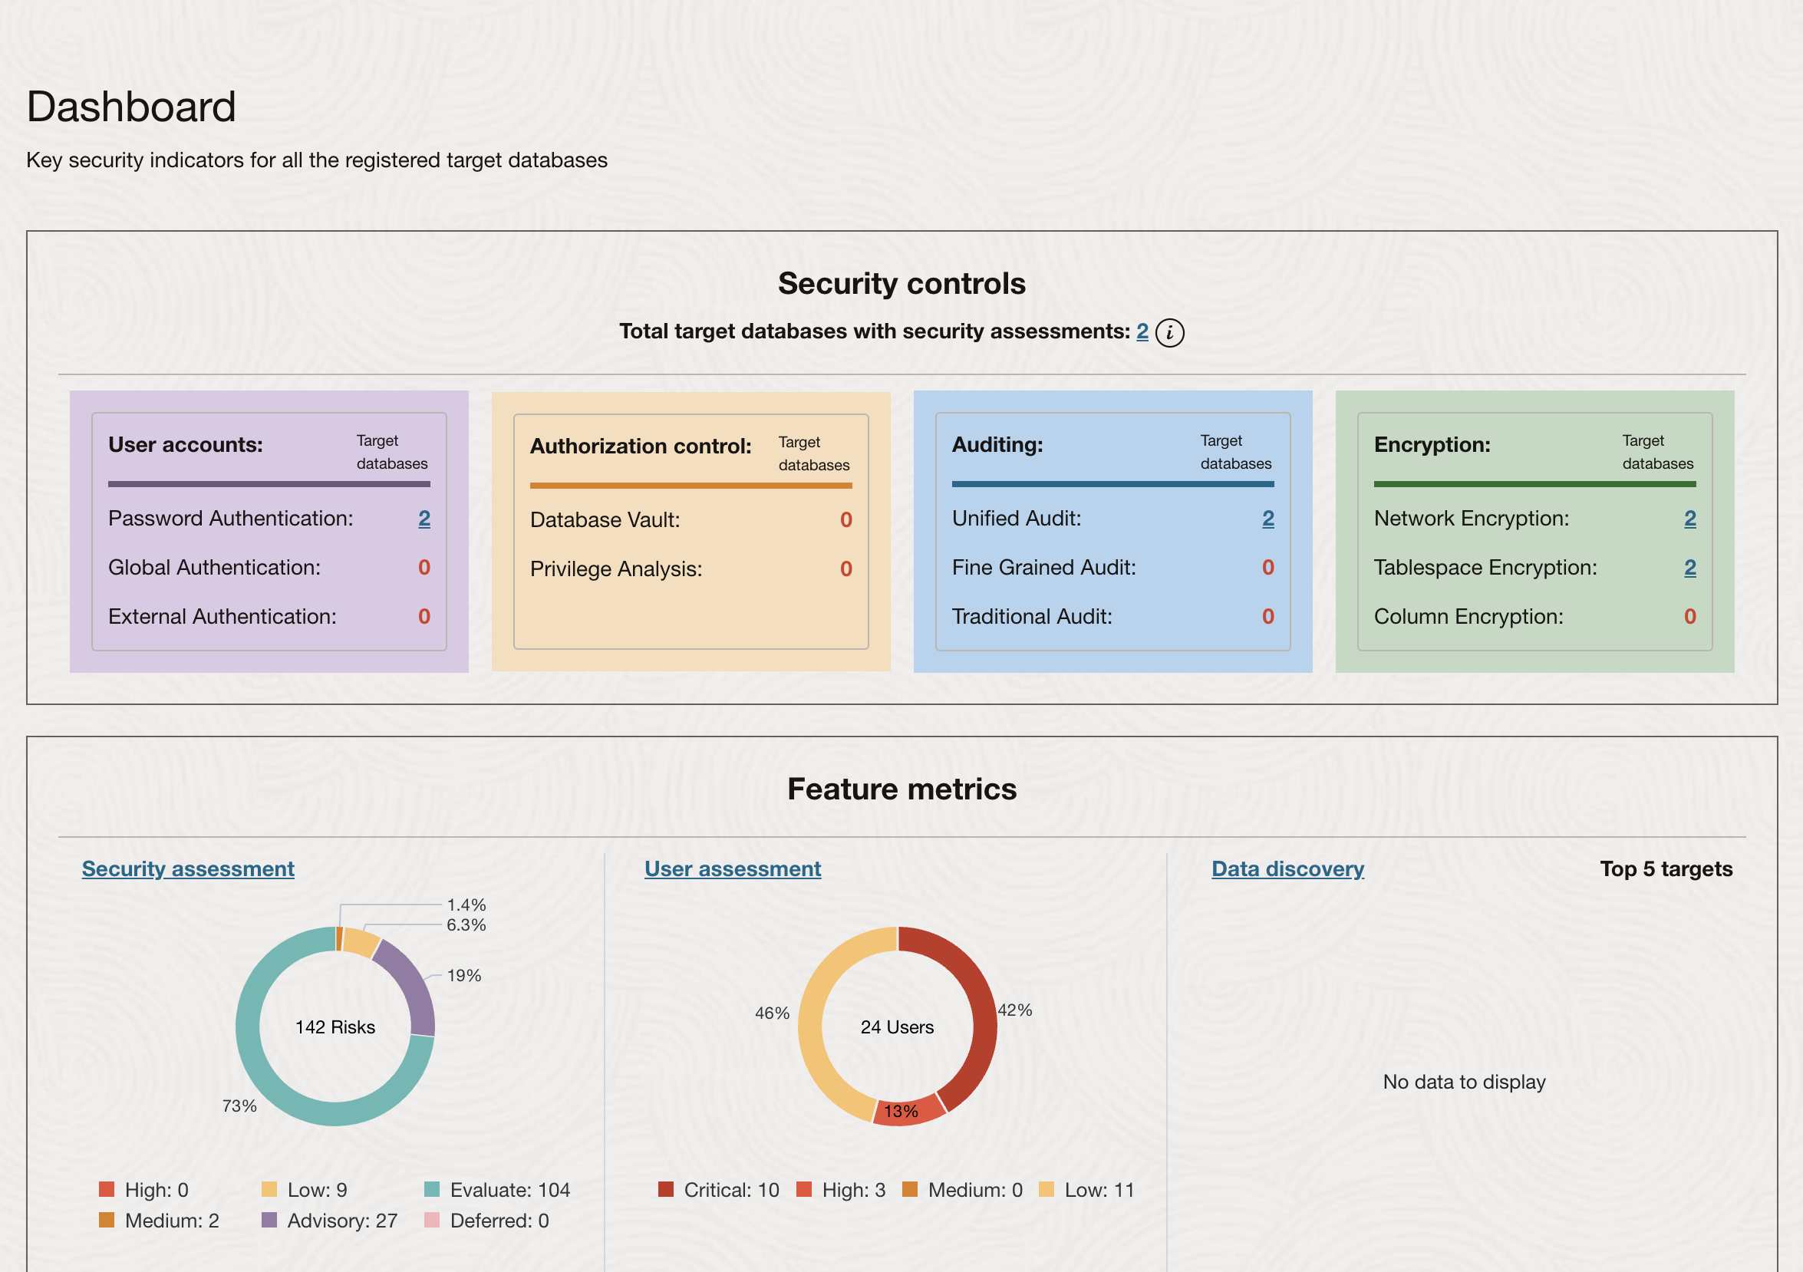
Data Safe Dashboard
Key Security Indicators at a Glance
Notes:
The Oracle Data Safe dashboard provides an overview of key security indicators across all registered databases. This central hub offers instant visibility into security status, helping us prioritize areas that need attention.
Key Sections:
Security Controls: Displays current security settings, including user authentication methods, authorization controls, audit configurations, and encryption status. This section quickly highlights areas lacking essential security controls, such as database vault or privilege analysis.
Feature Metrics: Summarizes assessments and activities, including:
Security Assessment: Visual representation of risks by severity—critical, high, medium, and low.
User Assessment: Details about users with elevated privileges or potential risks.
Data Discovery: Shows any discovered sensitive data across databases, aiding compliance efforts.
Activity and Alert Monitoring: Tracks recent user and admin activities, along with open alerts to help detect unusual behavior or potential threats.
This dashboard provides a high-level view of the security posture across both cloud and on-premises databases, serving as a launch point for more in-depth security assessments and actions. It streamlines the process, allowing users of all skill levels to manage and monitor database security efficiently.

Slide 8
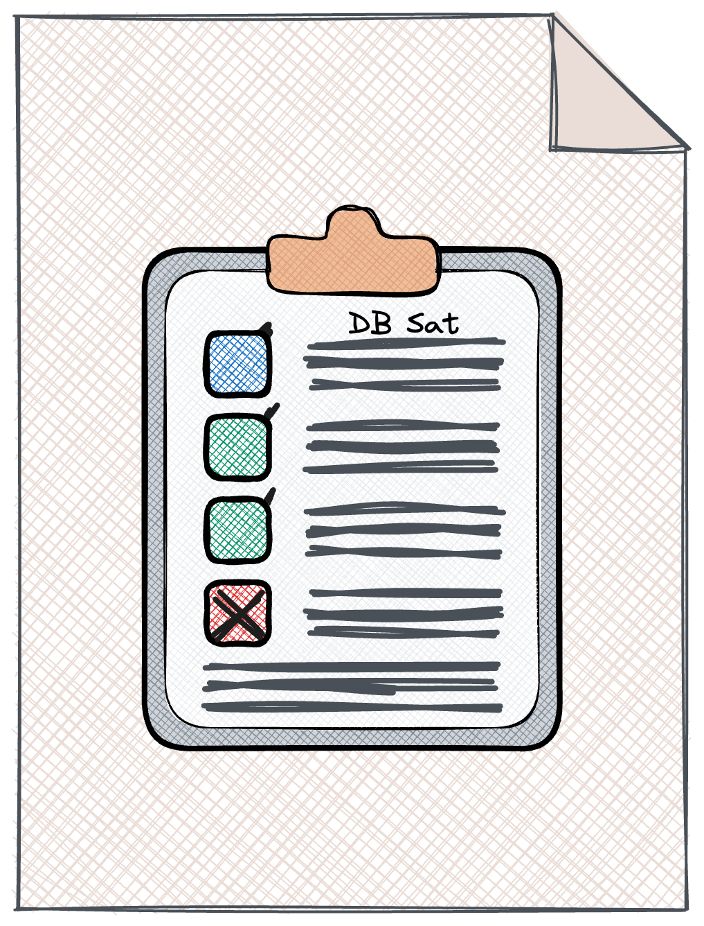
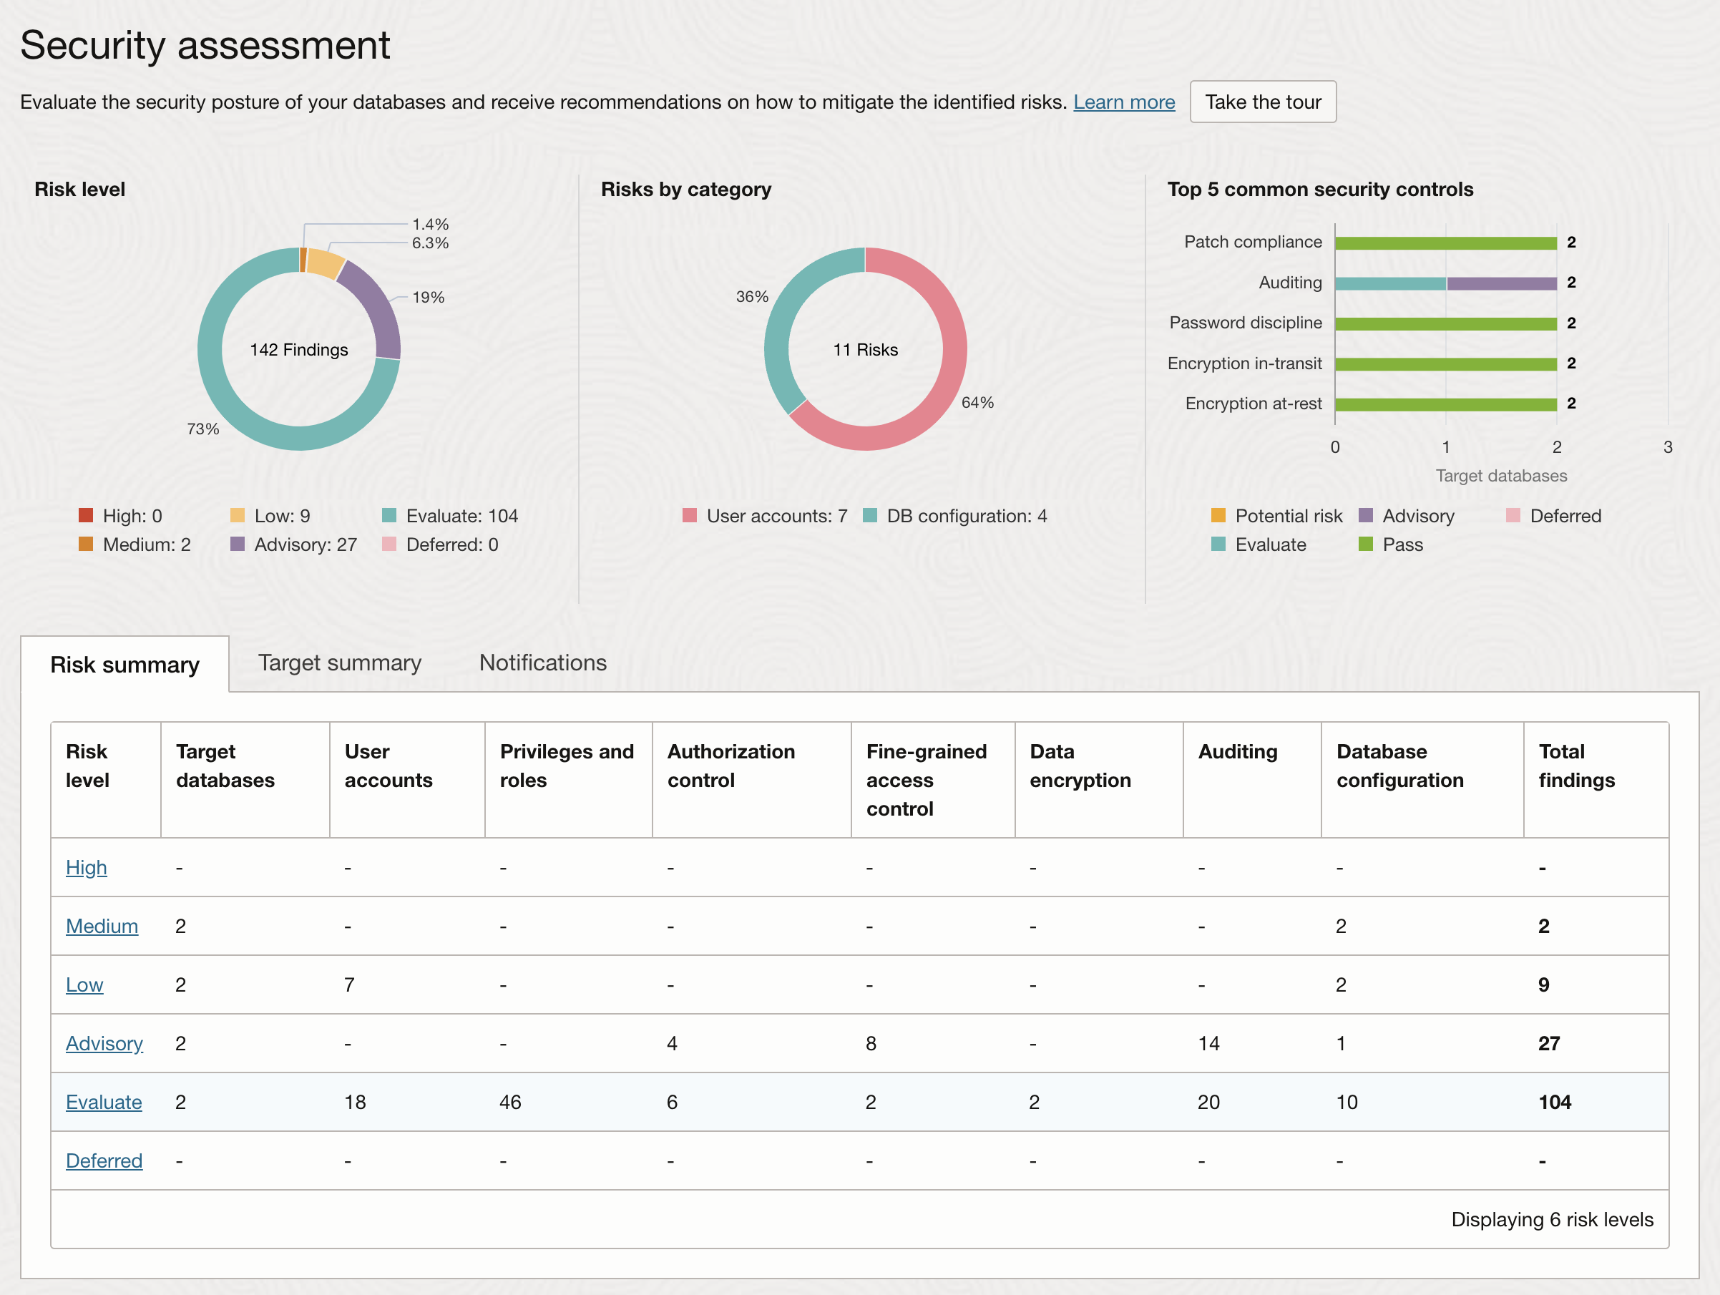
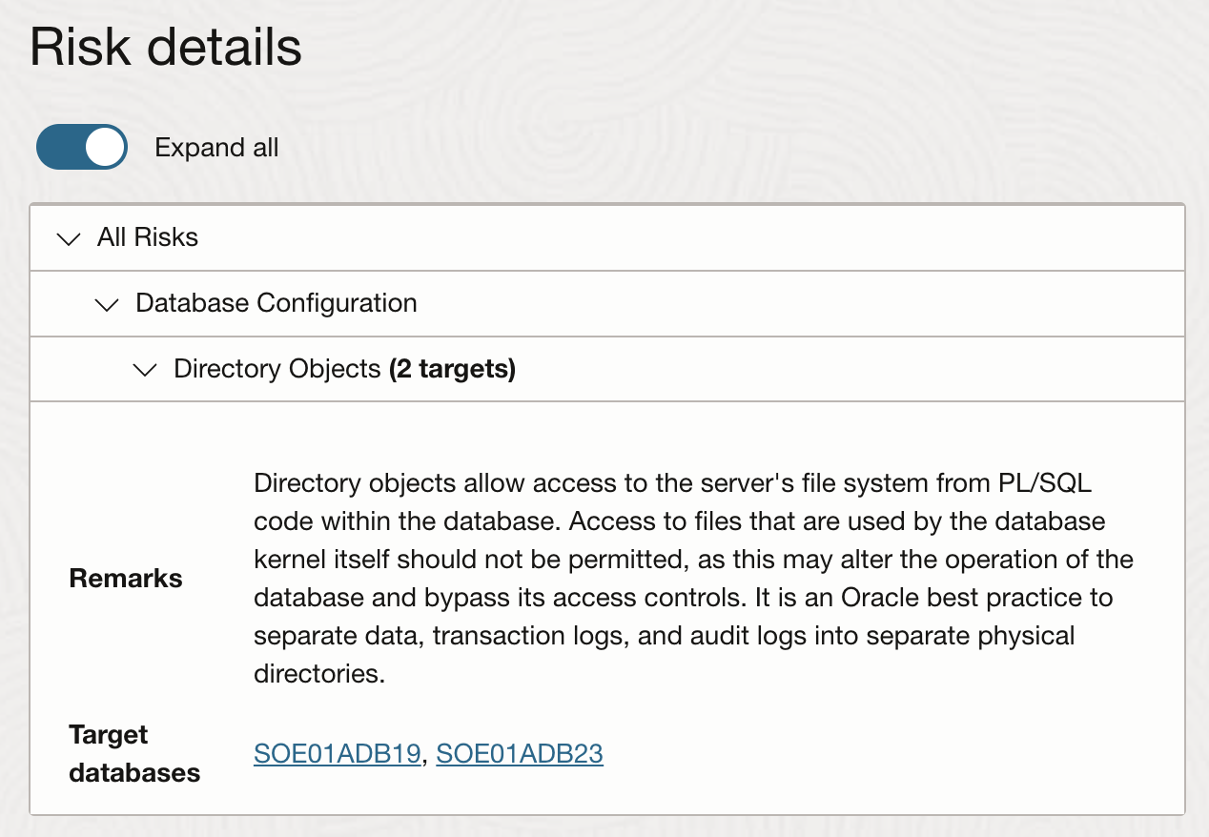
Database Security Assessment
Comprehensive Assessment
Security parameters
Security controls in use
User roles and privileges
Landscape-Wide Risk Overview
Identified risks with actionable recommendations
Compliance Mappings
Aligns with GDPR, STIG, CIS standards

Slide 9
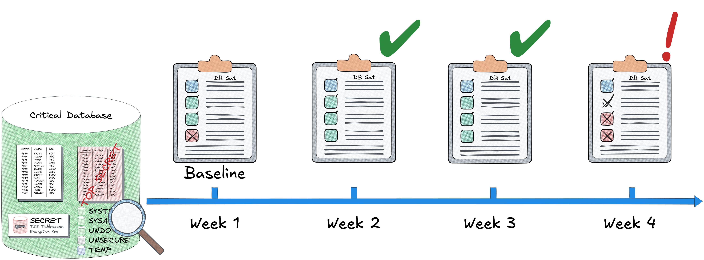
Database Security Assessment
Detecting Configuration Drifts
Establish a Security Baseline
Define a baseline configuration for secure operations.
Automatic Comparisons
New assessments are automatically checked against the baseline.
Notifications for Drift
Receive alerts and review any deviations from the baseline to address potential risks.
Notes:
In Oracle Data Safe, the Database Security Assessment feature allows us to establish a security baseline for our database configuration. This baseline serves as a reference for evaluating future configurations.
How It Works:
Once the baseline is set, all subsequent assessments are compared to this standard automatically.
Any deviations or "drifts" from this baseline configuration will trigger a notification, highlighting areas where security standards may have been compromised.
This process allows us to proactively monitor and address configuration changes that could introduce vulnerabilities, ensuring our databases remain secure over time. The graphic illustrates this weekly assessment cycle, where consistent checks help identify and resolve security issues before they escalate.

Slide 10

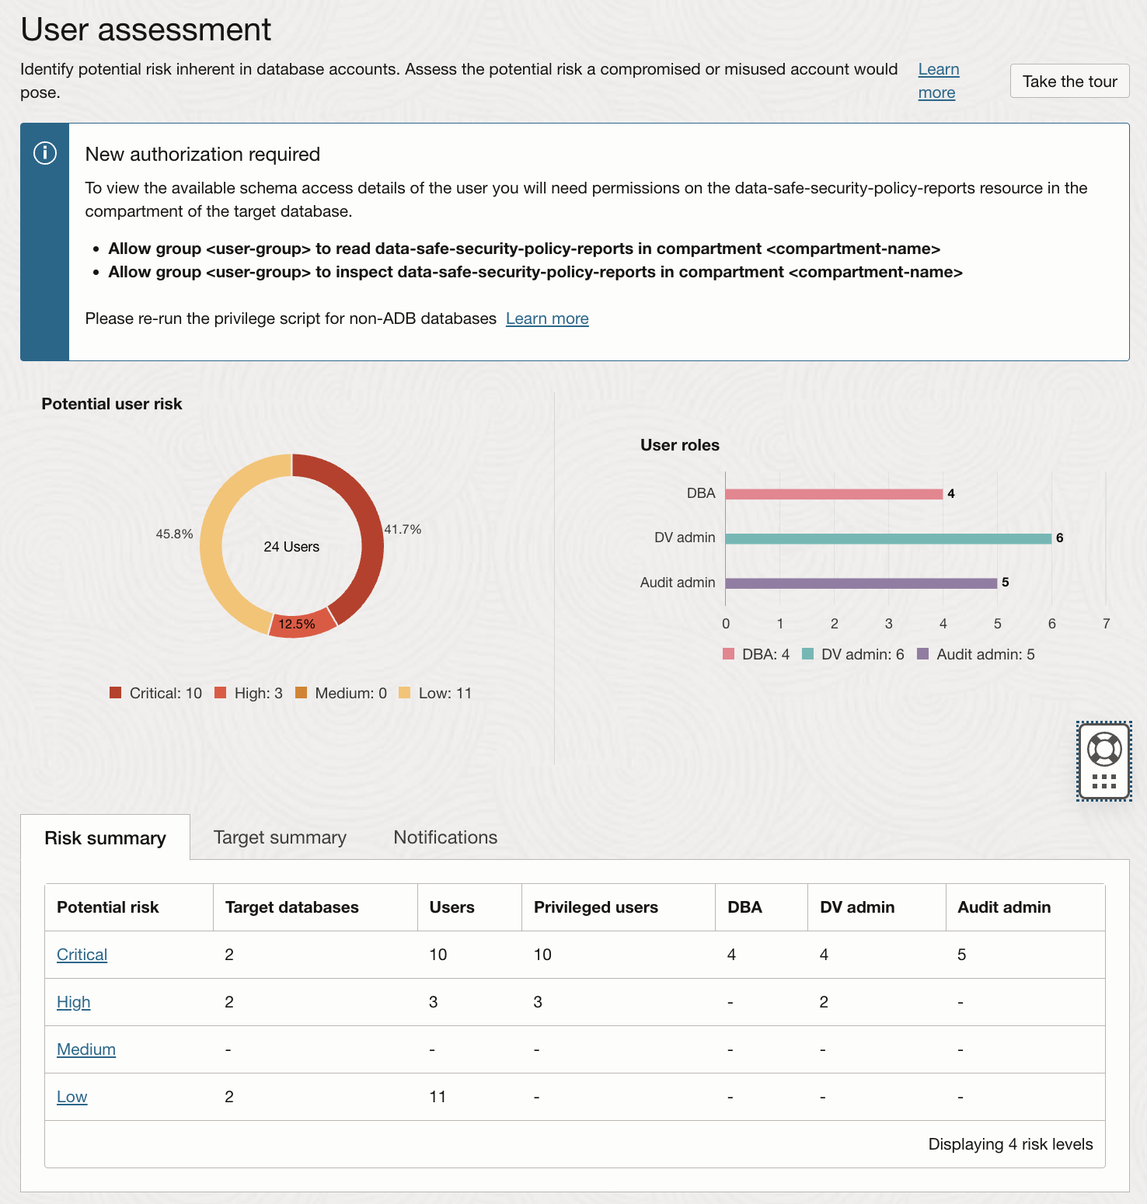
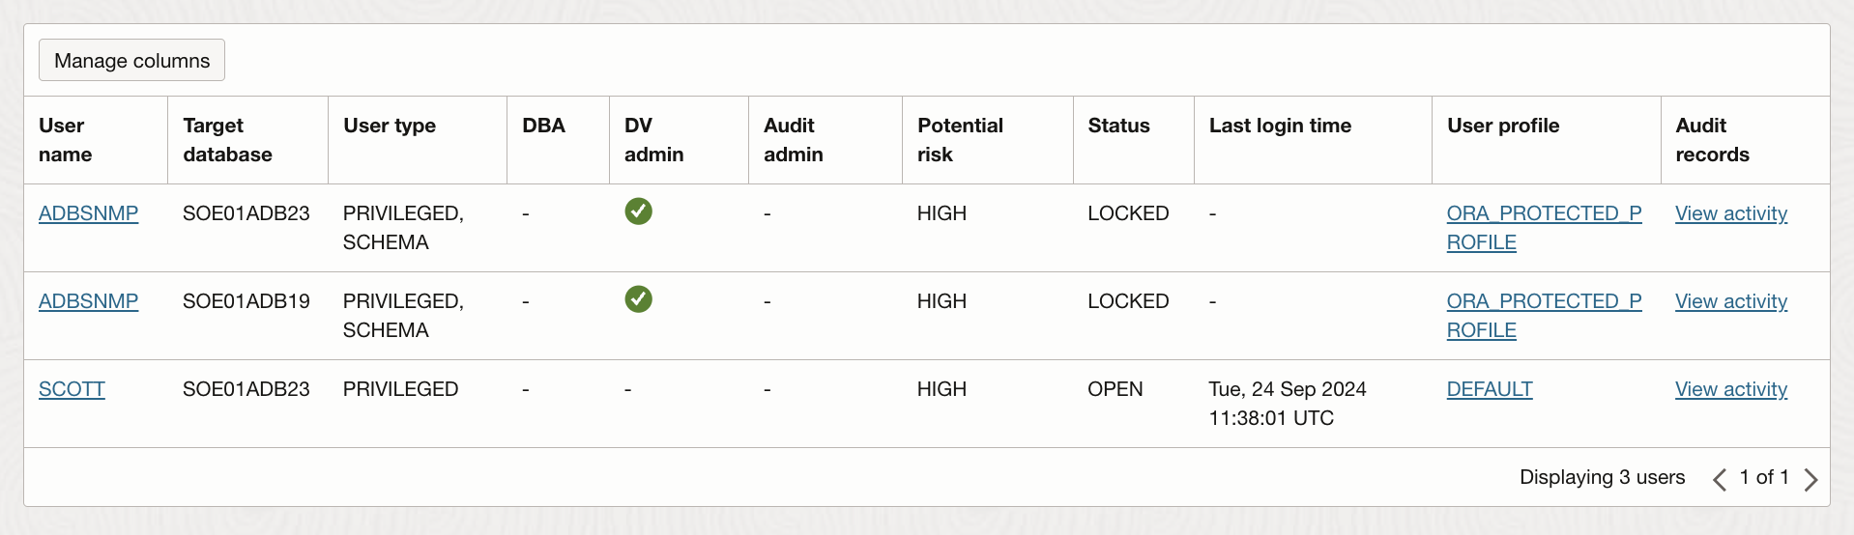
User Risk Assessment
Reducing Risk Through Role and Privilege Management
Identify High-Risk Users
Pinpoint users with elevated privileges who may pose security risks.
Review Roles and Privileges
Analyze assigned roles, object access, and system privileges.
Evaluate User Details
Check user details like last login, password change history, and recent database activity.
Notes:
The User Risk Assessment feature in Oracle Data Safe helps us identify and manage users who pose potential security risks due to their high-level privileges.
Key Functions:
Identify High-Risk Users: This feature allows us to identify users with elevated privileges, focusing on those with significant access to sensitive data or critical functions within the database.
Review Roles and Privileges: By examining each user's roles, object privileges, and system-level access, we can verify that privileges align with the principle of least privilege, minimizing unnecessary access.
Evaluate User Details: Additionally, Data Safe provides insights into user-specific details like the last login date, password change history, and recent activities. This helps us detect anomalies or inactive accounts that could pose security risks if compromised.
This tool supports proactive user management, ensuring that high-risk users are appropriately monitored and that access is aligned with security policies.

Slide 11
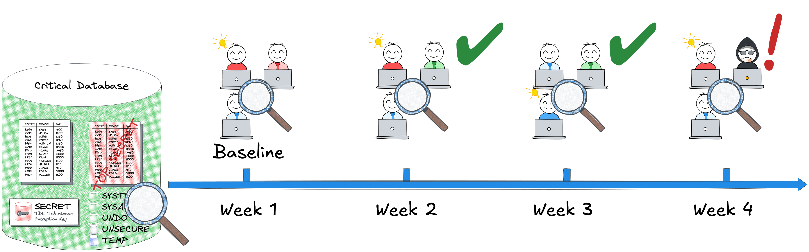
User Risk Assessment
Detecting User and Entitlement Changes
Periodic User Assessments
Regularly evaluate user accounts and privileges.
Compare with Previous Results
Identify changes by comparing new assessments with prior ones.
Alerts for Changes
Receive notifications for newly added users or modifications in user entitlements.

Slide 12
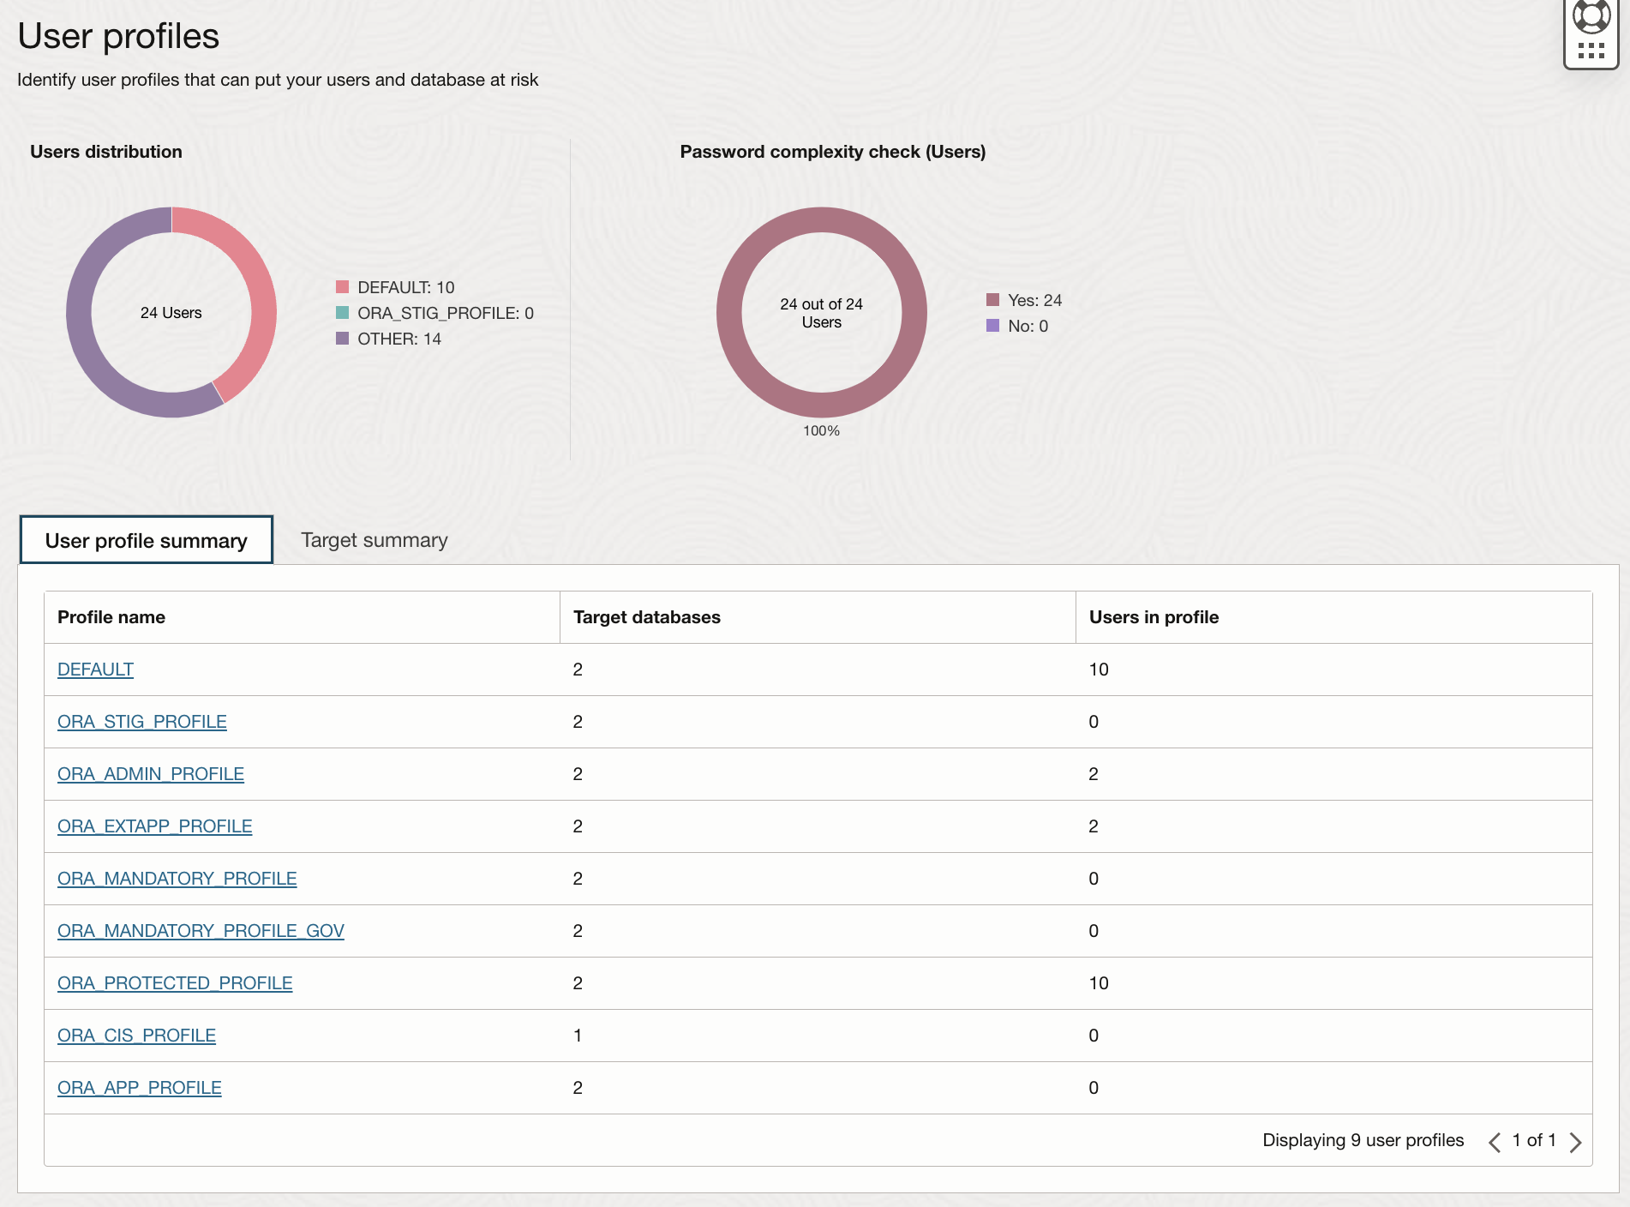
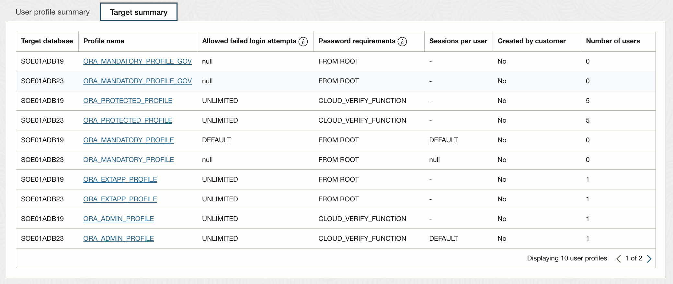
User Profile Insight
Evaluating Password-Related Attributes in User Profiles
Review User Profiles
Examine existing profiles and their security parameters.
Map Profiles to Users
Identify which users are assigned to specific profiles.
Detect Weak Profiles
Easily spot profiles and users lacking password complexity or other security measures.
Notes:
Oracle Data Safe provides detailed insights into user profiles, allowing us to evaluate and enhance password-related security settings.
Key Features:
Review User Profiles: This feature allows us to inspect existing user profiles, focusing on parameters that influence security, such as password expiration, complexity requirements, and account lockout policies.
Map Profiles to Users: By mapping profiles to individual users, we can ensure that each user’s access is governed by the appropriate security settings.
Detect Weak Profiles: One of the most valuable aspects of this feature is the ability to identify profiles and users without password complexity or other essential security functions. This enables us to strengthen weak profiles and apply consistent security standards across all user accounts.
This level of insight helps ensure that password policies are enforced consistently, reducing the risk of unauthorized access due to weak password policies.

Slide 13
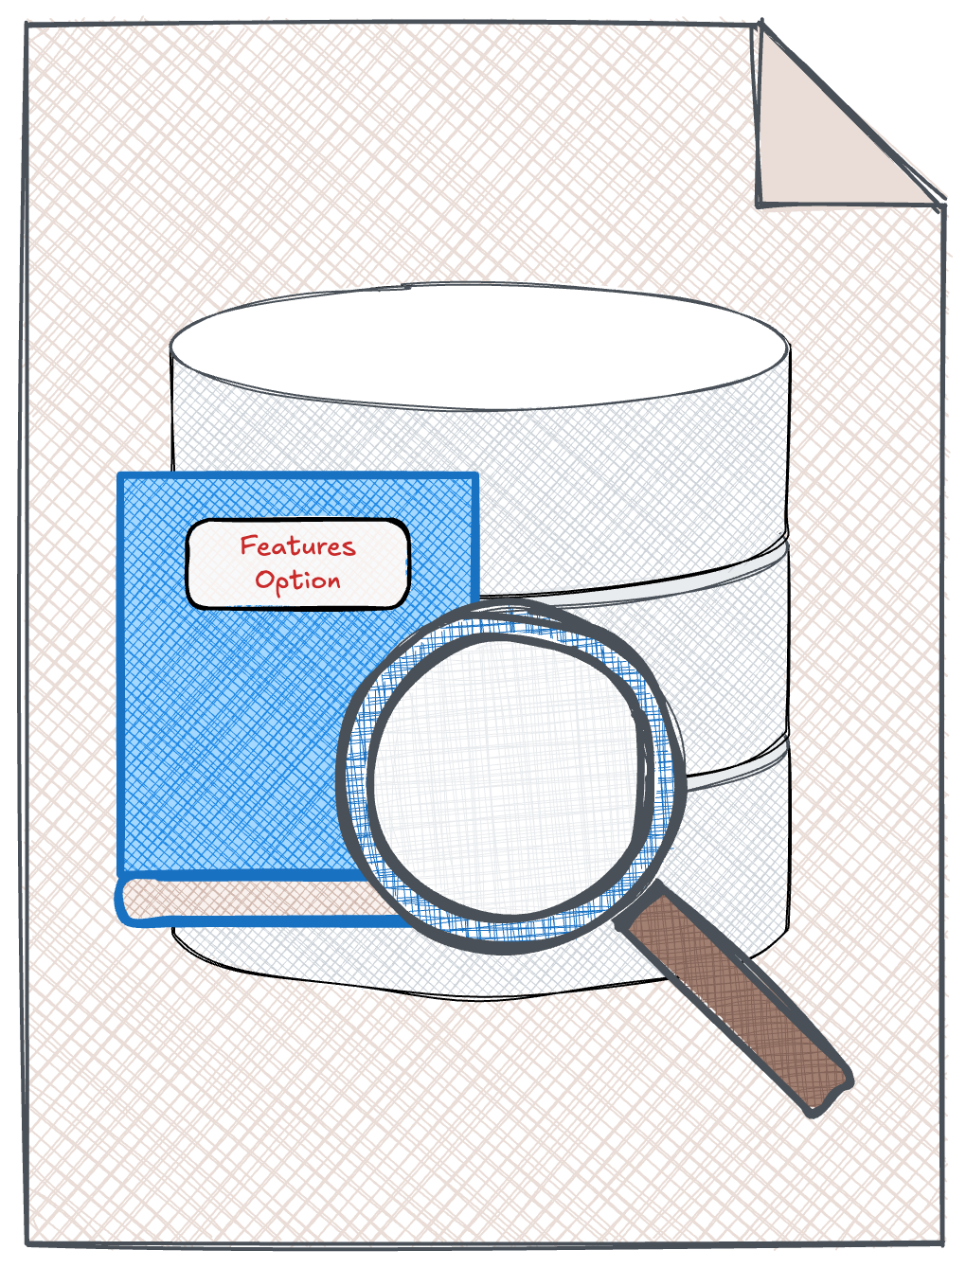
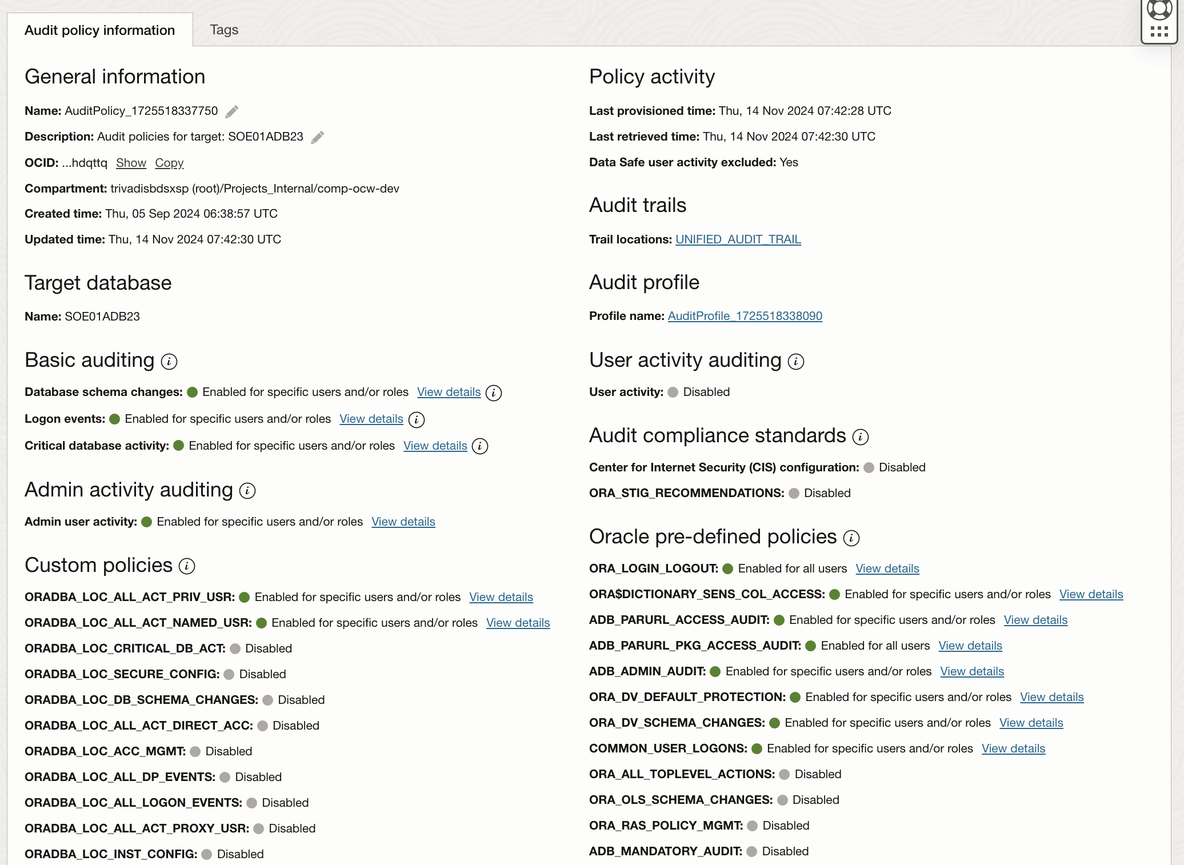
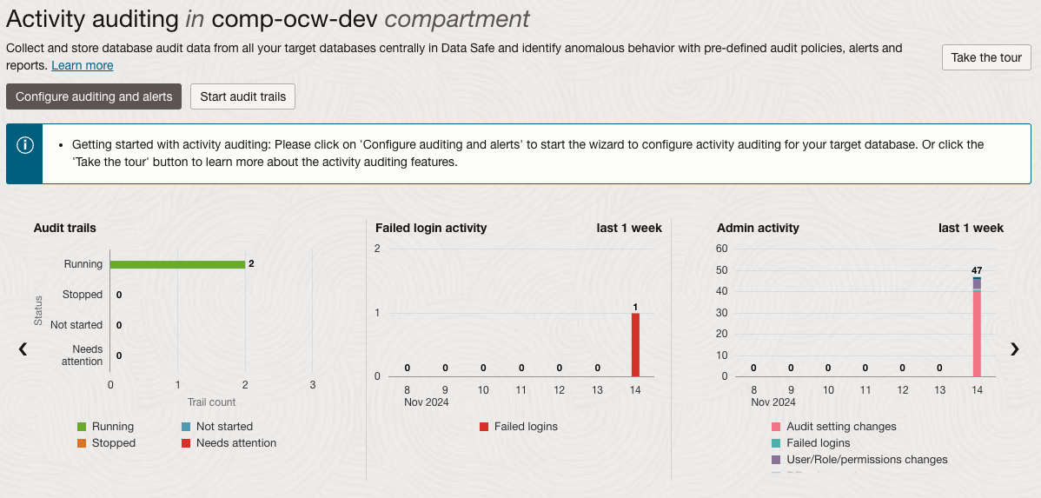
User Activity Auditing
Track User Actions with Comprehensive Auditing and Reporting
Audit and Compliance Policies
Define policies for auditing, compliance, and alerts.
Data Collection
Gather audit data from databases, focusing on sensitive operations.
Audit Reports:
Interactive Reports – For in-depth forensic analysis.
Summary & Detailed Reports –Tailored insights for different auditing needs.
PDF Compliance Reports – Ready-made reports for regulatory compliance.
Notes:
Oracle Data Safe’s User Activity Auditing feature enables us to monitor and track user actions within the database, essential for maintaining security and meeting compliance standards.
Key Functions:
Audit and Compliance Policies: With this feature, we can define audit policies that specify which actions to track, such as access to sensitive data or high-risk operations. Compliance policies and alert settings can also be configured to notify us of specific events.
Data Collection: Data Safe collects audit data directly from the databases, capturing records of user actions and sensitive operations. This data provides a comprehensive view of database activity.
Audit Reports:
Interactive Reports allow us to perform detailed forensic analysis, enabling quick investigation of unusual activity.
Summary & Detailed Reports offer flexible options for reporting based on the level of detail required, making it easier to monitor trends or focus on specific incidents.
PDF Compliance Reports are preformatted, making it simple to meet regulatory requirements by generating professional reports that can be shared with auditors or management.
This robust auditing system streamlines user activity tracking, helping us enforce policies, identify potential security incidents, and ensure compliance with ease.

Slide 14
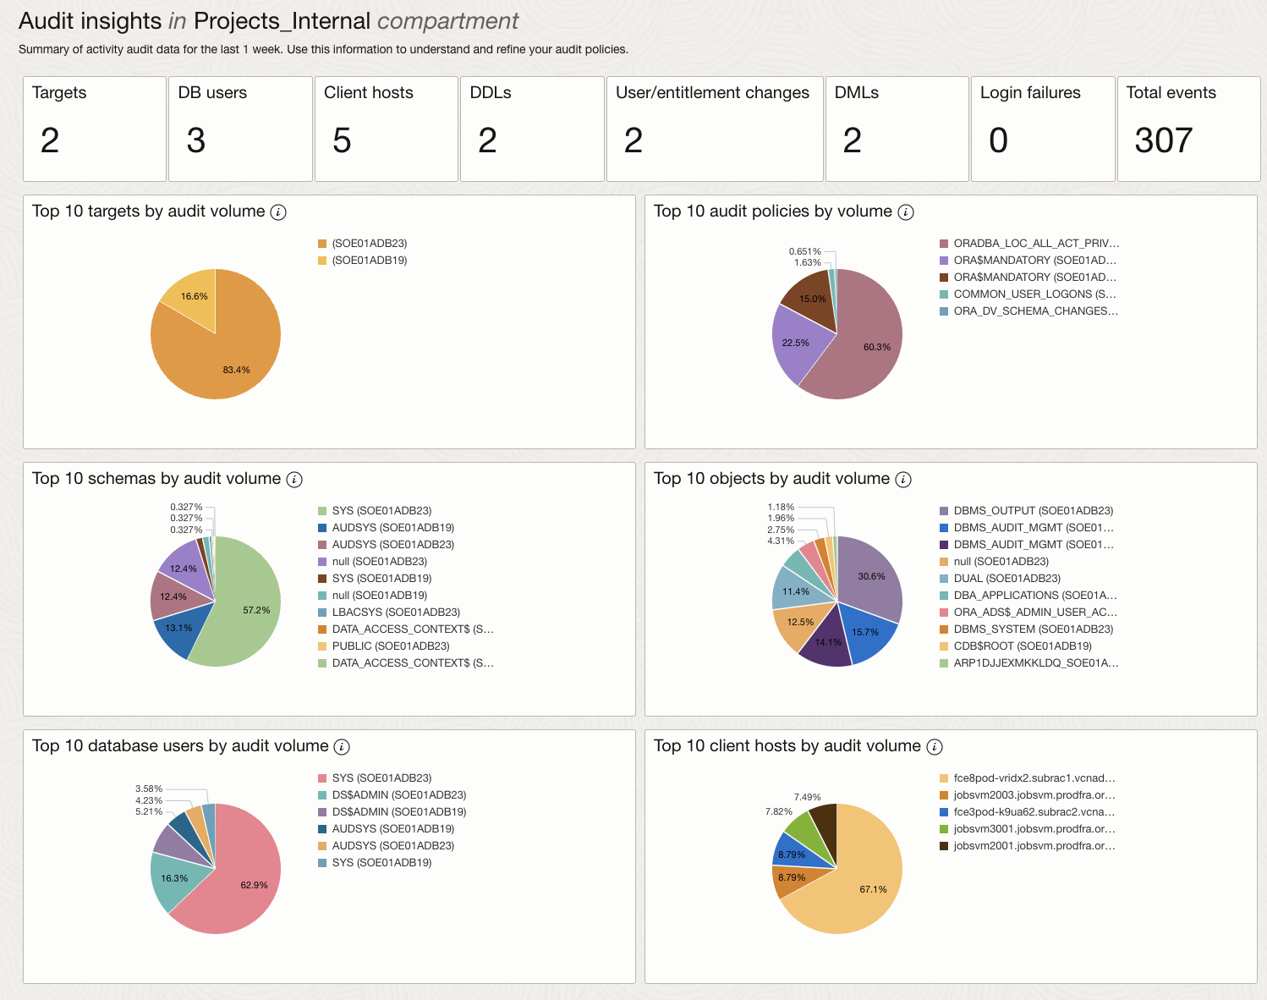
Audit Insights Dashboard
Fine-Tune Your Audit Policies
Gain Deeper Insights
Analyze audit data to optimize policies.
High-Volume Policies
Identify which audit policies generate the most records.
Top Targets
See which databases produce the highest audit volumes.
Frequent Access Patterns
Discover the most-accessed objects and schemas.
Notes:
The Audit Insights Dashboard in Oracle Data Safe provides a deeper view into audit data, allowing us to fine-tune and optimize audit policies effectively.
Key Insights:
High-Volume Policies: The dashboard highlights which audit policies generate the largest volume of records. This helps us identify overly broad or high-activity policies that may need adjustment to reduce noise and focus on meaningful events.
Top Targets: By showing which target databases are producing the most audit records, we can understand where the bulk of activity is occurring and prioritize resources or scrutiny accordingly.
Frequent Access Patterns: The dashboard also reveals the most-accessed objects and schemas, helping us detect patterns, spot unusual access trends, and adjust policies to better protect sensitive data.
These insights allow us to optimize our auditing approach, ensuring it’s both effective in capturing relevant data and efficient in managing audit volumes.

Slide 15
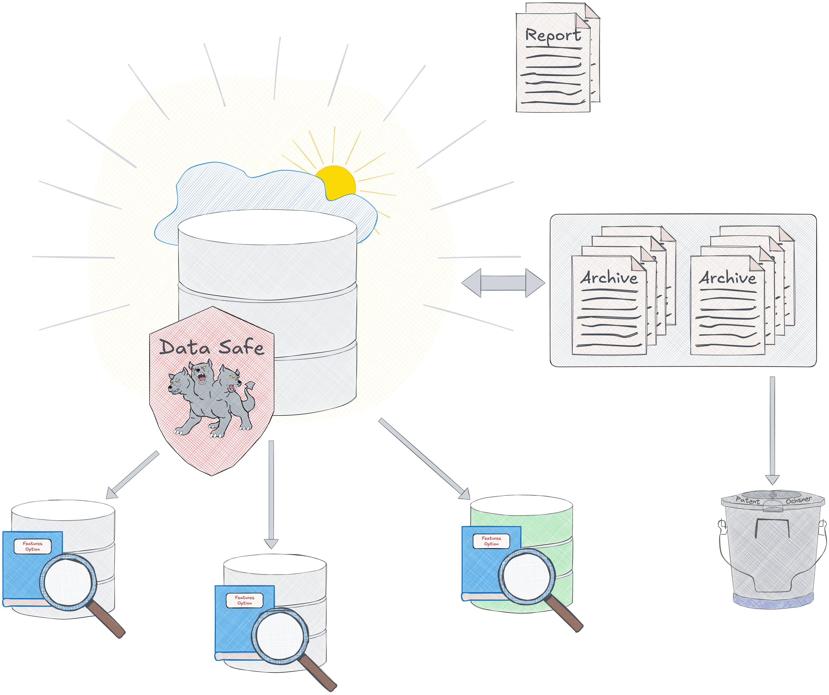
Audit Data Retention Management
Ensure Compliance with Retention Policies
Retention Periods
Store audit data for up to 7 years
Online Retention – Up to 1 year
Archive Retention – Up to an additional 6 years
Configurable Retention
Set retention periods globally or for specific targets.
Easy Access to Archived Data
Quickly retrieve audit records as needed.
Fully Managed by Data Safe
No additional fees for archiving audit data…. … as long as it is not too much data per month
Notes:
Oracle Data Safe’s Audit Data Retention Management feature supports compliance with regulatory and corporate retention policies by offering flexible storage options for audit data.
Key Details:
Retention Periods: Audit data can be retained for up to 7 years in total, with the first year available online for quick access, and up to an additional 6 years stored in an archive for long-term retention.
Configurable Retention: You can configure these retention periods either globally for all databases or individually for specific targets, giving you control over how long each target's data is kept.
Easy Access to Archived Data: Data Safe makes it simple to retrieve archived audit records when needed for compliance reviews or investigations.
Fully Managed by Data Safe: This feature is fully managed within Data Safe, and archiving comes at no extra cost, making it a cost-effective solution for meeting retention requirements.
This flexibility helps organizations meet data retention standards, ensuring audit data is available for as long as needed without the hassle of manual management or added expenses.

Slide 16
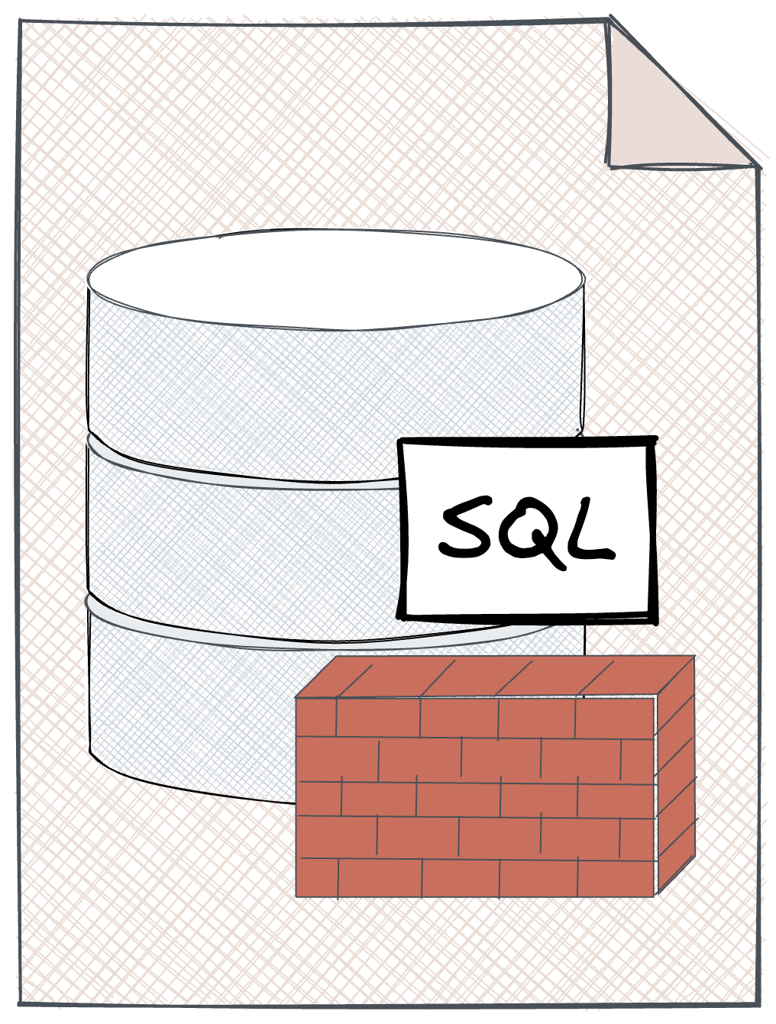
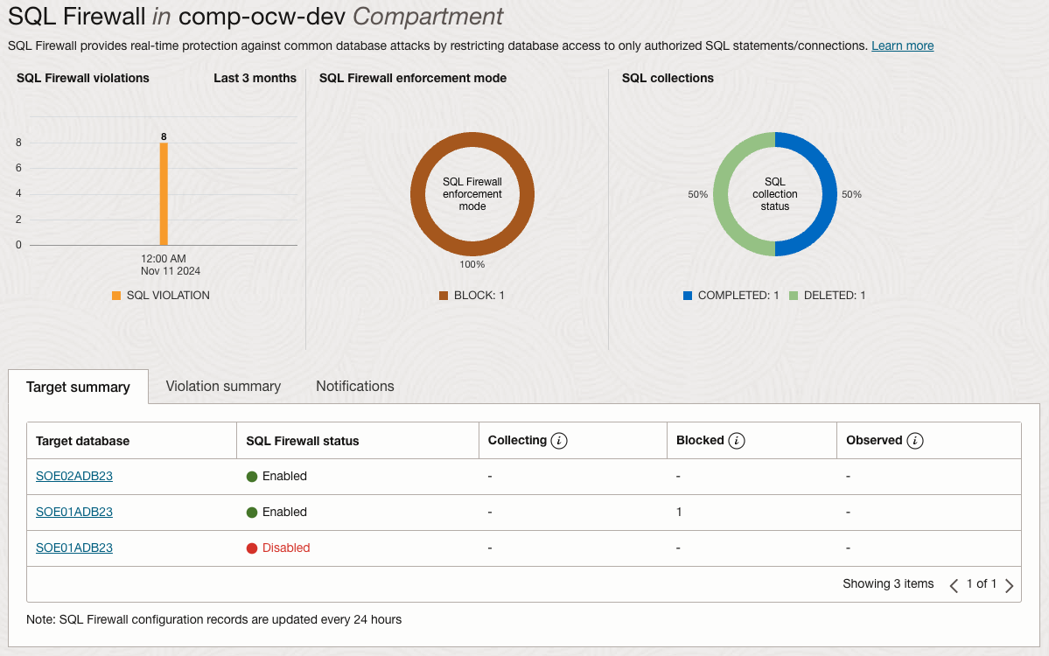
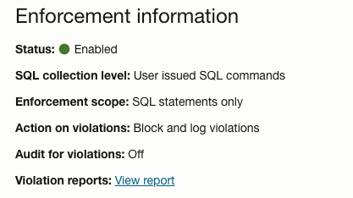
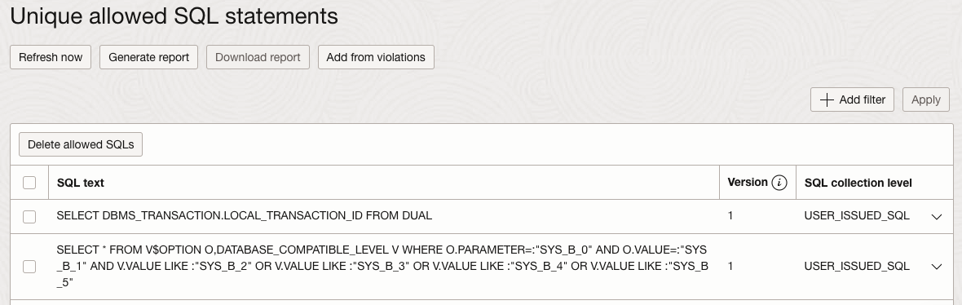
SQL Firewall
Prevent SQL Injection and Unauthorized Access
Real-Time Protection
Restricts database access to only authorized connections and SQL statements.
Monitor or Block Violations
Choose to either monitor or block any access violations.
Risk Mitigation
Defends against SQL injection, unauthorized access, and credential abuse.
Currently only available in Oracle 23ai
Notes:
Oracle Data Safe’s SQL Firewall provides an essential layer of real-time defense for your database by controlling and filtering SQL statements at the entry point.
Key Features:
Real-Time Protection: The SQL Firewall only allows database access from authorized connections and permits only approved SQL statements, ensuring that potentially harmful or unexpected SQL commands are blocked before they reach the database.
Monitor or Block Violations: For flexible security management, you can choose to either monitor violations for audit purposes or actively block them, allowing you to tailor responses to specific security needs.
Risk Mitigation: This feature effectively reduces the risk of common threats such as SQL injection attacks, unusual access patterns, and misuse of credentials by blocking anomalous access attempts and unauthorized commands.
The SQL Firewall enhances database security by proactively guarding against vulnerabilities and unauthorized actions, giving you greater control and protection over your database environment.

Slide 17
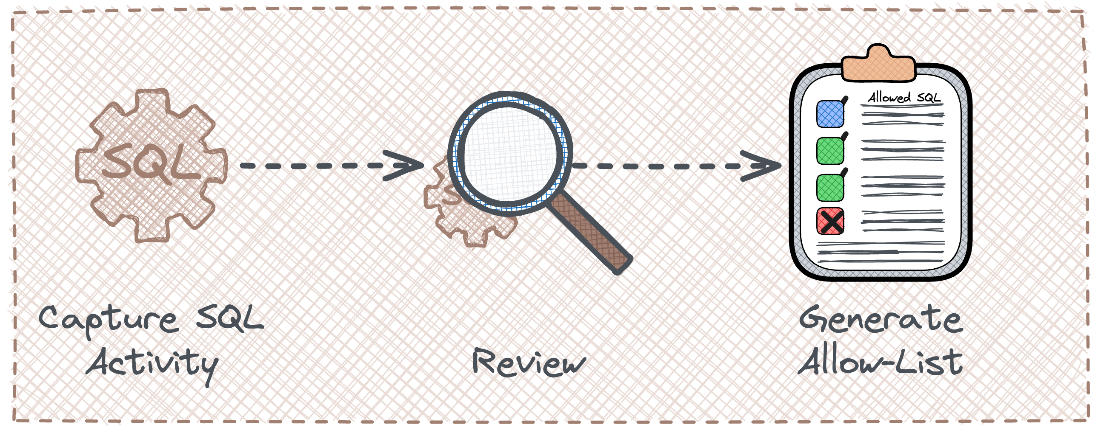
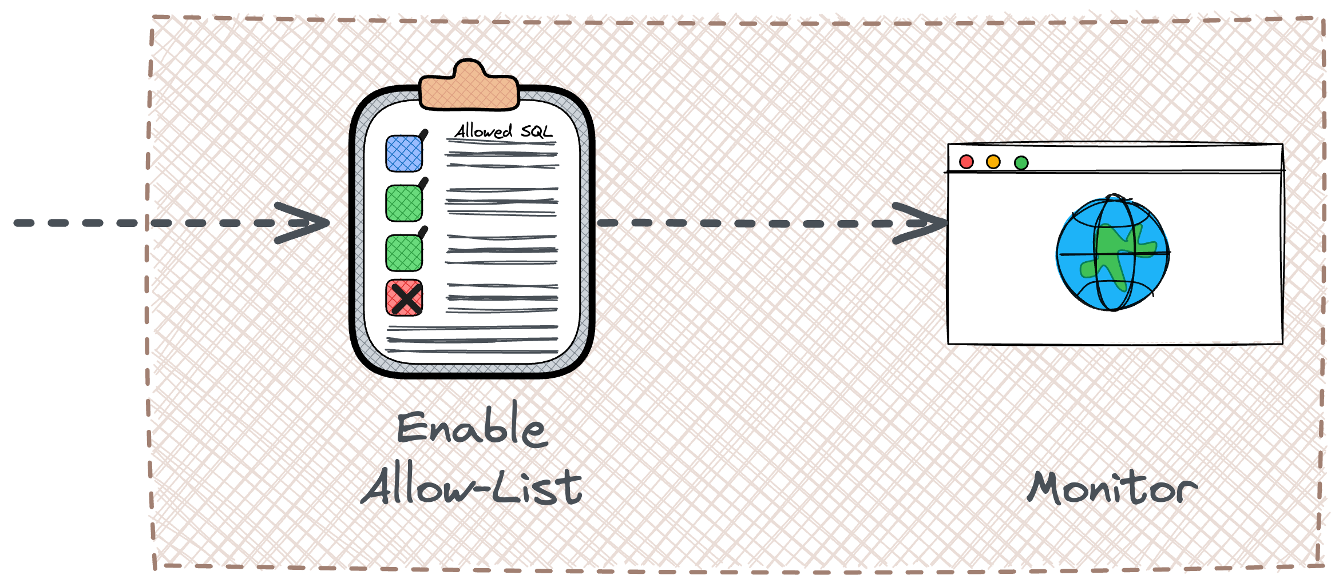
Navigating SQL Firewall – Processes
Understanding the Mechanics and Strategies for Optimal Deployment
Learning Stage
Collect Enable collection of SQL statements and user connections.
Review & Configure Review collected SQL statements and connections, then define allowed connections as needed.
Set Permissions: Adjust allowed SQL statements and user connections based on security requirements.
Protecting Stage
Enable the allow-list
Monitor violations SQL Firewall raises violation for any unexpected access patterns to ensure compliance
Notes:
Oracle Data Safe’s SQL Firewall is designed for easy setup and management, providing a straightforward approach to securing database access.
Steps for Configuring SQL Firewall:
Collect: Begin by turning on the collection of SQL statements and user connections, allowing the firewall to gather information on typical database activity.
Review & Configure: Once collection is complete, review the SQL statements and connections recorded. Based on this data, you can define which user connections are permitted and identify potentially suspicious activity.
Set Permissions: Modify the list of allowed SQL statements and connections to ensure only authorized actions are permitted, minimizing the risk of unauthorized access.
Monitor: After configuration, monitor the firewall for any policy violations. This ongoing monitoring helps identify and respond to security incidents promptly.
This intuitive process provides a robust, easily managed barrier against SQL injection and unauthorized database access, helping to maintain a secure database environment.

Slide 18

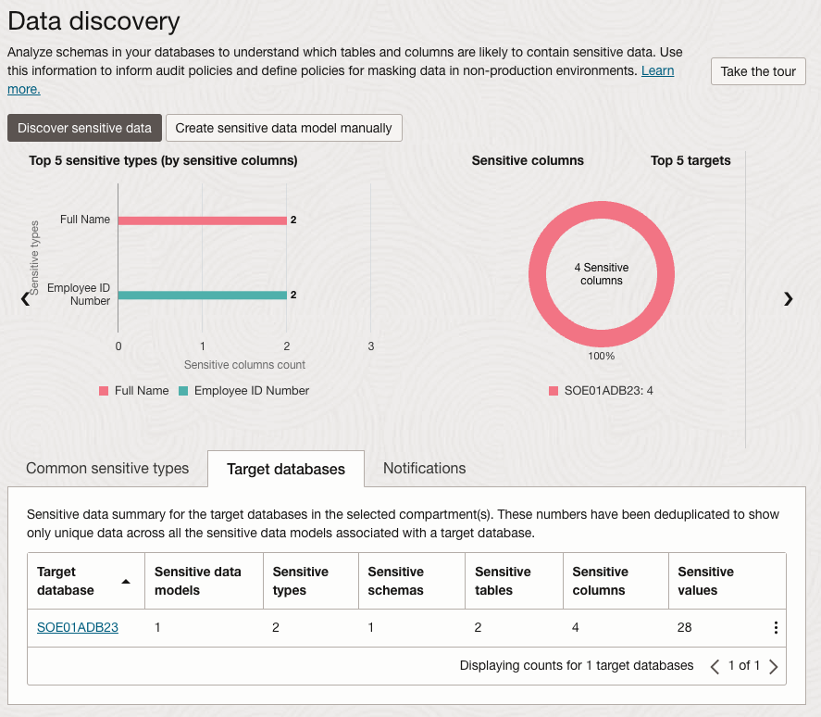
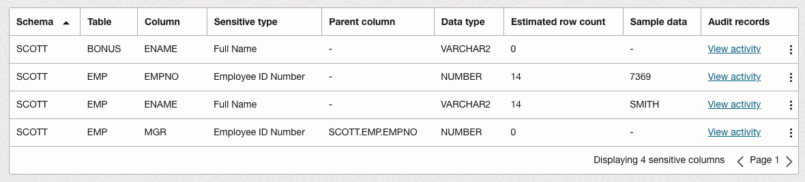
Sensitive Data Discovery
Identify and Classify Sensitive Data to Prioritize Security Efforts
Predefined Sensitive Types
Detects and classifies over 150 sensitive data types.
Custom Sensitivity Definitions
Allows user-defined sensitive data types for tailored discovery.
Incremental Discovery
Supports ongoing scans to identify newly added sensitive data.
Detailed Reporting
Provides reports on the amount and types of sensitive data.
Notes:
Oracle Data Safe’s Sensitive Data Discovery feature helps organizations focus their security efforts by identifying sensitive data within databases.
Key Capabilities:
Predefined Sensitive Types: Data Safe can detect and classify over 150 types of sensitive data, including personal information, financial data, and other high-risk information, providing a comprehensive view of sensitive assets.
Custom Sensitivity Definitions: You can add user-defined sensitive types to the discovery process, allowing for customized data classification based on your organization’s unique needs.
Incremental Discovery: This feature supports incremental scans, enabling ongoing discovery of sensitive data as it is added to the database. This ensures that newly added sensitive data is quickly identified and protected.
Detailed Reporting: Data Safe generates reports detailing the type and volume of sensitive data discovered. These insights help prioritize security resources and focus on protecting areas with the highest risk.
Sensitive Data Discovery enables proactive data management, helping to minimize exposure and align security practices with data protection regulations.

Slide 19


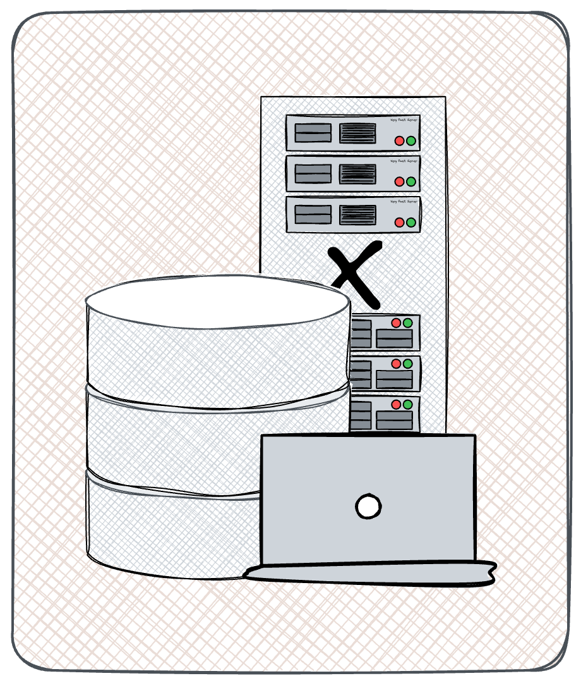




Sensitive Data Discovery
150+ Pre-Defined Sensitive Data Types
Identification | Biographic | IT | Financial | Healthcare | Employment | Academic
SSN Name Email Phone Passport DL Tax ID … | Age Gender Race Citizenship Address Family Data Date of Birth Place of Birth … | IP Address User ID Password Hostname GPS location … | Credit Card CC Security PIN Bank Name Bank Account IBAN Swift Code … | Provider Insurance Height Blood Type Disability Pregnancy Test Results ICD Code … | Employee ID Job Title Department Hire Date Salary Stock … | College Name Grade Student ID Financial Aid Admission Date Graduation Date Attendance …

Slide 20
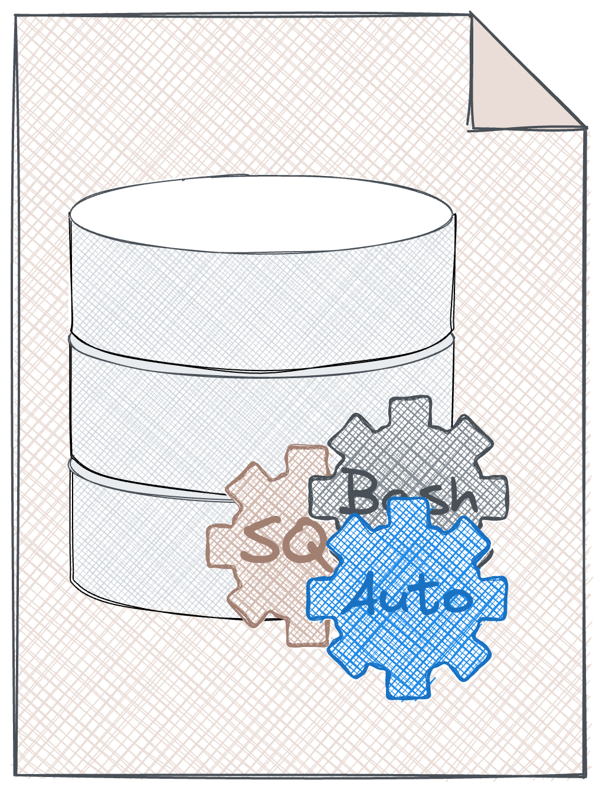
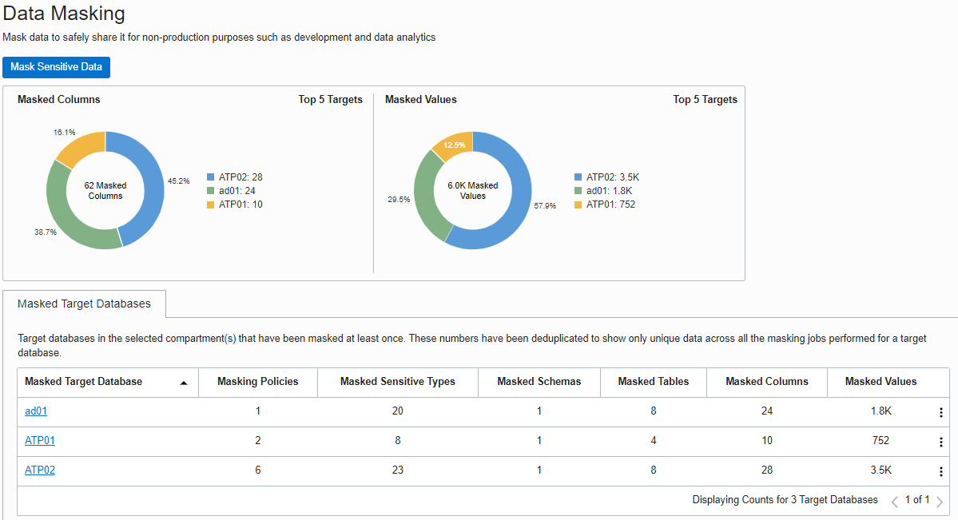
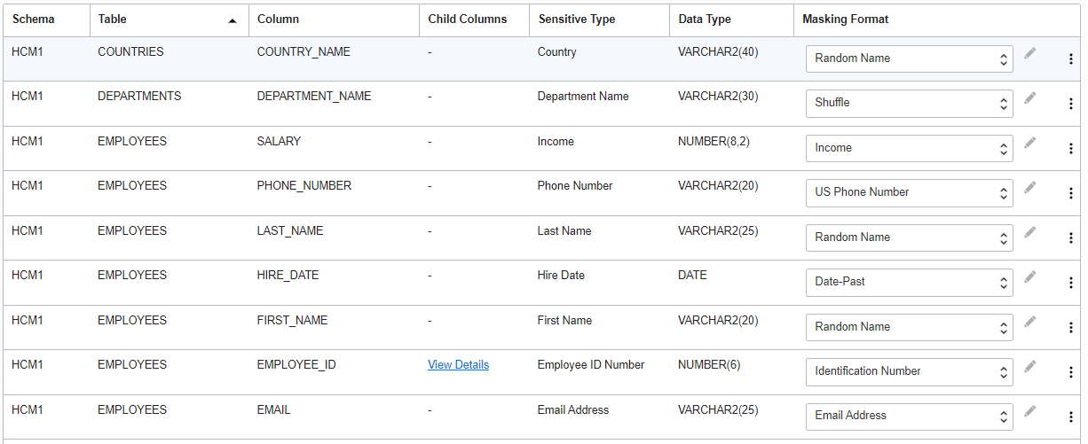
Sensitive Data Masking
Minimize Sensitive Data Exposure in Development and Testing
Sensitive Data Masking
Mask data identified as sensitive to protect privacy.
Predefined Masking Formats
Over 50 predefined formats for common data types.
Automated Format Selection
Automatically selects appropriate formats based on data type.
Custom Masking Options
Supports user-defined formats for specialized requirements.
Advanced Transformations
Offers rich masking options for complex data scenarios.
Comprehensive Masking Report
Detailed reports on masked data for compliance and review.
Notes:
Oracle Data Safe’s Sensitive Data Masking feature enables secure handling of sensitive information in non-production environments, such as development, testing, partner environments, and analytics databases.
Key Features:
Sensitive Data Masking: This feature allows you to apply masking to data identified as sensitive, rendering it unreadable to unauthorized users while still useful for testing and analysis.
Predefined Masking Formats: Data Safe provides over 50 predefined formats for commonly sensitive data types, such as names, addresses, and social security numbers, ensuring quick and consistent masking.
Automated Format Selection: Based on the type of sensitive data, Data Safe can automatically choose the appropriate masking format, simplifying setup and ensuring data is consistently protected.
Custom Masking Options: For unique data types, user-defined masking formats can be created, allowing flexibility to adapt to specific organizational needs.
Advanced Transformations: Rich masking transformations handle complex scenarios, such as generating realistic but fictional values for testing scenarios.
Comprehensive Masking Report: After masking, a detailed report is generated, outlining what data was masked, which formats were used, and the extent of the transformation. This report supports compliance documentation and auditing.
Sensitive Data Masking reduces exposure risk while allowing essential development and testing activities to proceed securely, supporting data privacy and regulatory compliance.

Slide 21
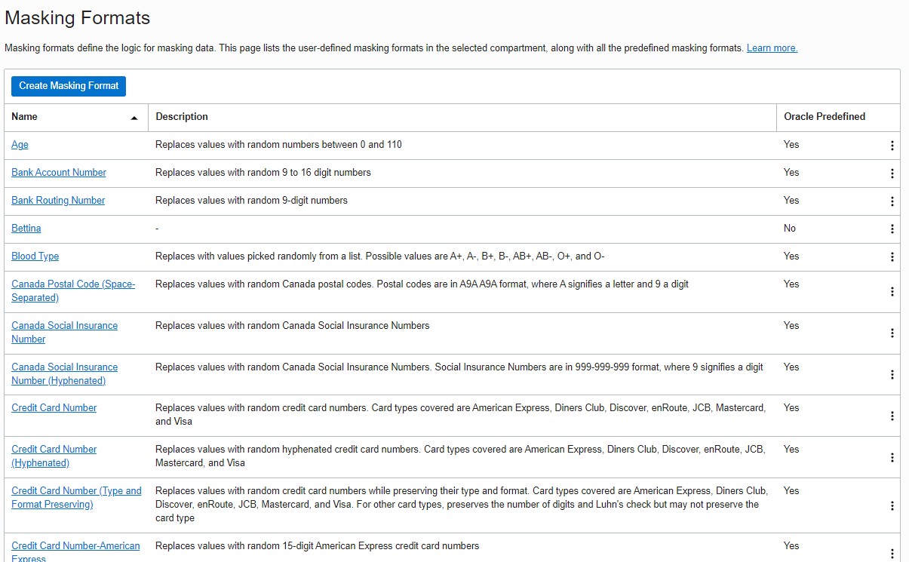
Sensitive Data Masking
Pre-Defined Masking Formats for Comprehensive Data Protection
50+ Pre-Defined Formats
Data Safe offers a wide range of masking options, including
Specific Formats – Social security number, credit card number, email address, and more.
Generic Formats – Random date, random number, random name, fixed number, fixed string.
Advanced Techniques – Format-preserving randomization, regular expression, data truncation, group masking.
Notes:
Oracle Data Safe’s Sensitive Data Masking feature provides over 50 pre-defined masking formats to support various masking needs, from commonly sensitive information to more generic data types.
Key Masking Options:
Specific Formats: For highly sensitive data like social security numbers, credit card numbers, and email addresses, Data Safe provides specific masking formats that ensure this data is fully protected while maintaining realistic structure.
Generic Formats: For more flexible masking, Data Safe includes generic options, such as generating random dates, numbers, or names. Fixed values like a set number or string can also be applied where consistent placeholders are needed.
Advanced Techniques:
Format-Preserving Randomization: Maintains the data’s original format while randomizing values, making it useful for testing without revealing real data.
Regular Expression Masking: Allows customized masking patterns for complex data.
Truncation and Group Masking: Truncates data to reduce exposure or applies consistent masking across grouped records to support use cases where relational integrity must be preserved.
These versatile masking formats ensure that sensitive data remains secure, supporting a wide range of applications and compliance needs in non-production environments.

Slide 23
Register an Autonomous Database with Oracle Data Safe
Assess Database Configurations and Users
Discover and Mask Sensitive Data
Audit Database Activity
Generate Alerts

Slide 24
Slide 13: Configuring Oracle Data Safe
Title: Step 1 - Configuring Oracle Data Safe
Subtitle: Connecting and Setting Up Data Safe with ADB
Content: Step-by-step guide to enable Data Safe, set up connections with ADB, and verify connectivity.

Slide 25
Slide 14: Running a Security Assessment
Title: Step 2 - Running a Security Assessment
Subtitle: Identifying Security Gaps in Your ADB Instance
Content: Instructions for running a Security Assessment, reviewing findings, and interpreting results for security improvements.

Slide 26
Slide 15: Configuring Audit Settings
Title: Step 3 - Configuring Audit Settings
Subtitle: Monitoring Database Activities
Content: Guide to configuring audit policies in Data Safe, defining audit trails, and generating audit reports.

Slide 27
Slide 16: Performing a User Assessment
Title: Step 4 - Performing a User Assessment
Subtitle: Reviewing User Privileges and Roles
Content: Walkthrough of conducting a User Assessment to identify users with elevated privileges and access patterns.

Slide 28
Slide 17: Discovering Sensitive Data
Title: Step 5 - Discovering Sensitive Data
Subtitle: Scanning for and Classifying Sensitive Data in ADB
Content: Instructions on how to perform a Sensitive Data Discovery scan and classify sensitive information in the database.

Slide 29
Slide 19: Key Takeaways
Title: Key Takeaways from Oracle Data Safe
Subtitle: Summary of Data Safe Features and Workshop Highlights
Content: Recap of Data Safe’s capabilities, key security benefits, and lessons from the workshop.
Slide 20: Q&A
Title: Questions and Answers
Subtitle: Addressing Participant Queries
Content: Open floor for questions, with a reminder of where participants can find additional resources and support.

Slide 30
Thank You

